Slide 1
Estimation of population parameters
Abundance
Fecundity
Survival

Slide 2
Scientists know how to count, right??
Yet in the U.S. <50% of recovery plans for ESA listed species included an estimate of current population size, N.
75% lacked a rigorous estimate.
Why do we know so little
about the size of wild populations,
even when they are of high conservation priority?
Notes:
Only 4% had a trend. For more than 95% of ENDANGERED SPECIES in richest country with data/scientists, no one knew whether the population was growing, shrinking or stable?
ACTIVITY: 2 minutes – to list why – focus on biological reasons

Slide 3
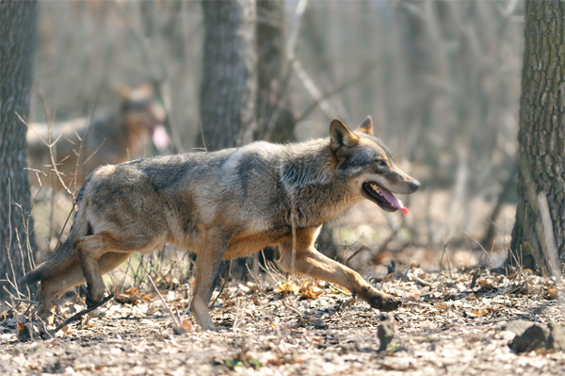
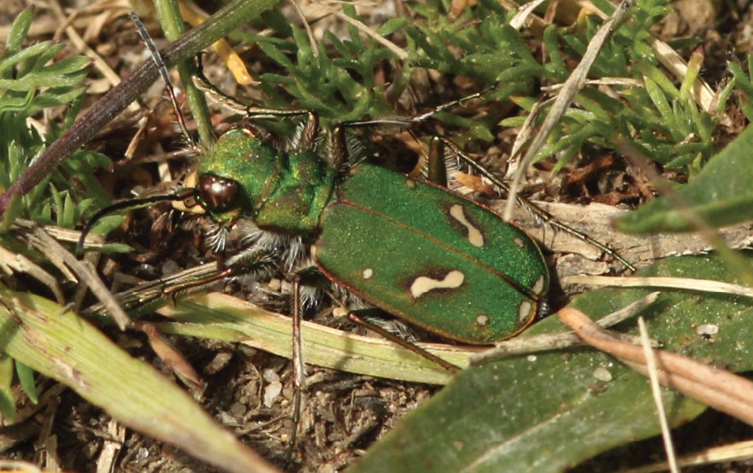
Why is estimating population size so challenging?
Expensive
Time consuming
Biological challenges:
  Detectability: aquatic species, subterranean spp., elusive spp., cryptic species
  Mobility
  Wide ranging species
  Patchy distributions
Notes:
OHLONE tiger beetle – usually blended in grass, even experts have trouble spotting them, let along making an accurate / comprehensive count.

Slide 4
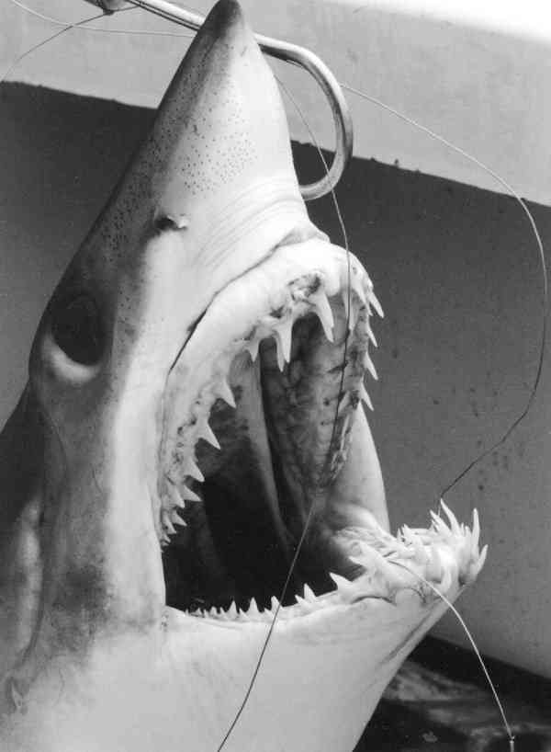
Estimating population size
Definitions
Census – All individuals are counted (perfect detectability)
Abundance = how many individuals (e.g., 100)
Density = abundance per unit area (e.g., 10/ha)
Sample: usually standardized e.g. by time, space, effort:
e.g. catch per unit effort, individuals detected per time or area unit
Abundance estimate – Actual estimate of abundance or density, often by accounting for detectability
Abundance Index – Some measure assumed to be proportional to abundance or density (relative abundance).
Notes:
4
COUNTS work only for IMMOBILE SPEICES, in LTD. Area with all life stages readily visible. FOR MOST SPEICES CENSUSES are impossible or prohibitively expensive.
Index – e.g. fisheries CPUE, species that can’t be seen: e.g. vocalizations or footprints, nests, burrows.

Slide 5
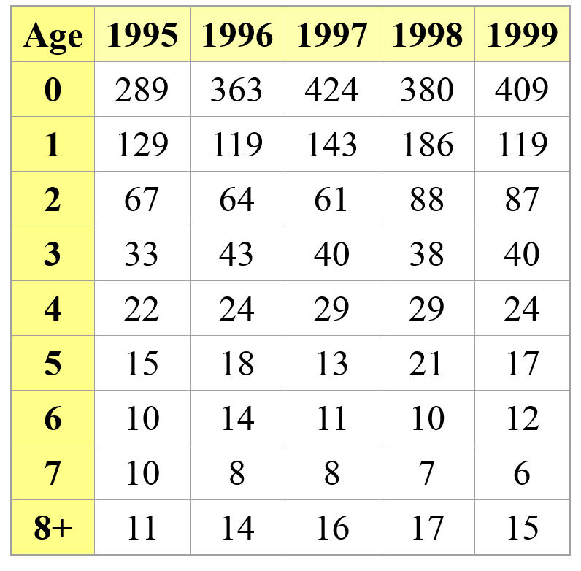
Estimating survival and fecundity using census data
Assume we do several censuses in a closed population (no emigration and immigration), assuming perfect detection

Slide 6
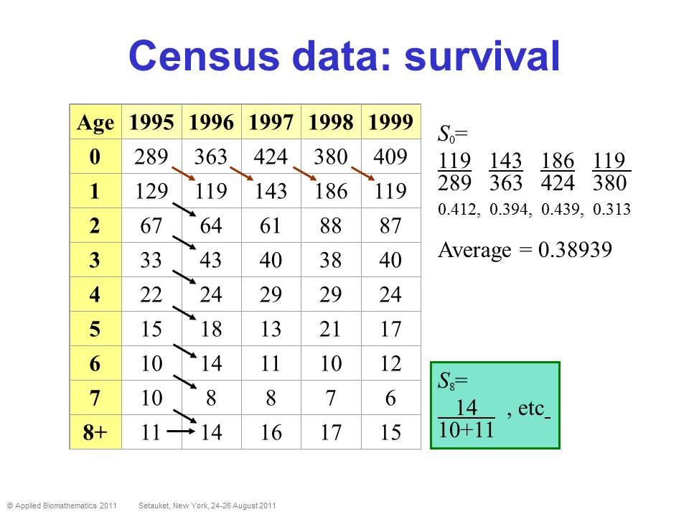
Estimating survival and fecundity using census data
Assume we do several censuses in a closed population (no emigration and immigration), assuming perfect detection

Slide 7
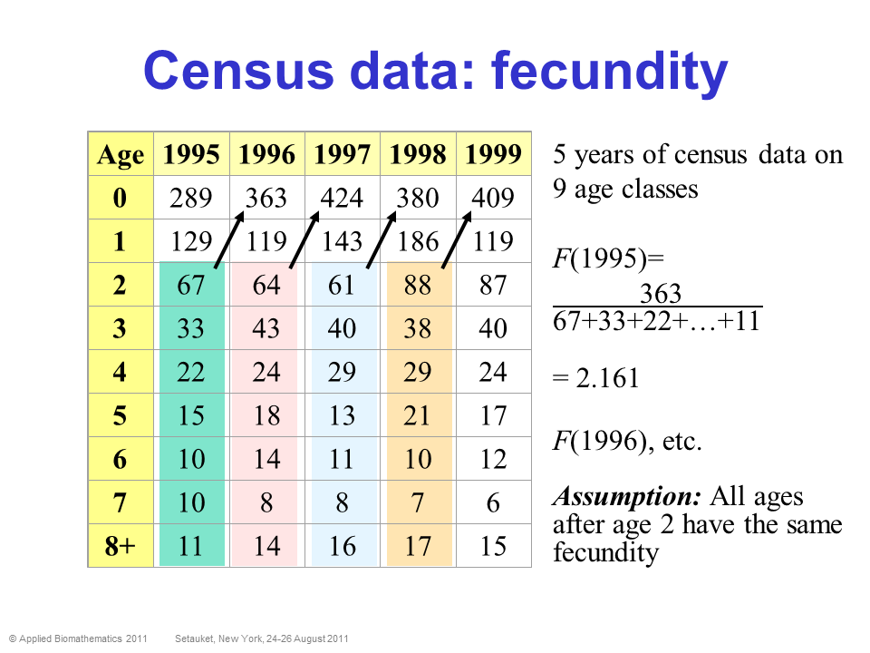
Estimating survival and fecundity using census data
Assume we do several censuses in a closed population (no emigration and immigration), assuming perfect detection

Slide 8
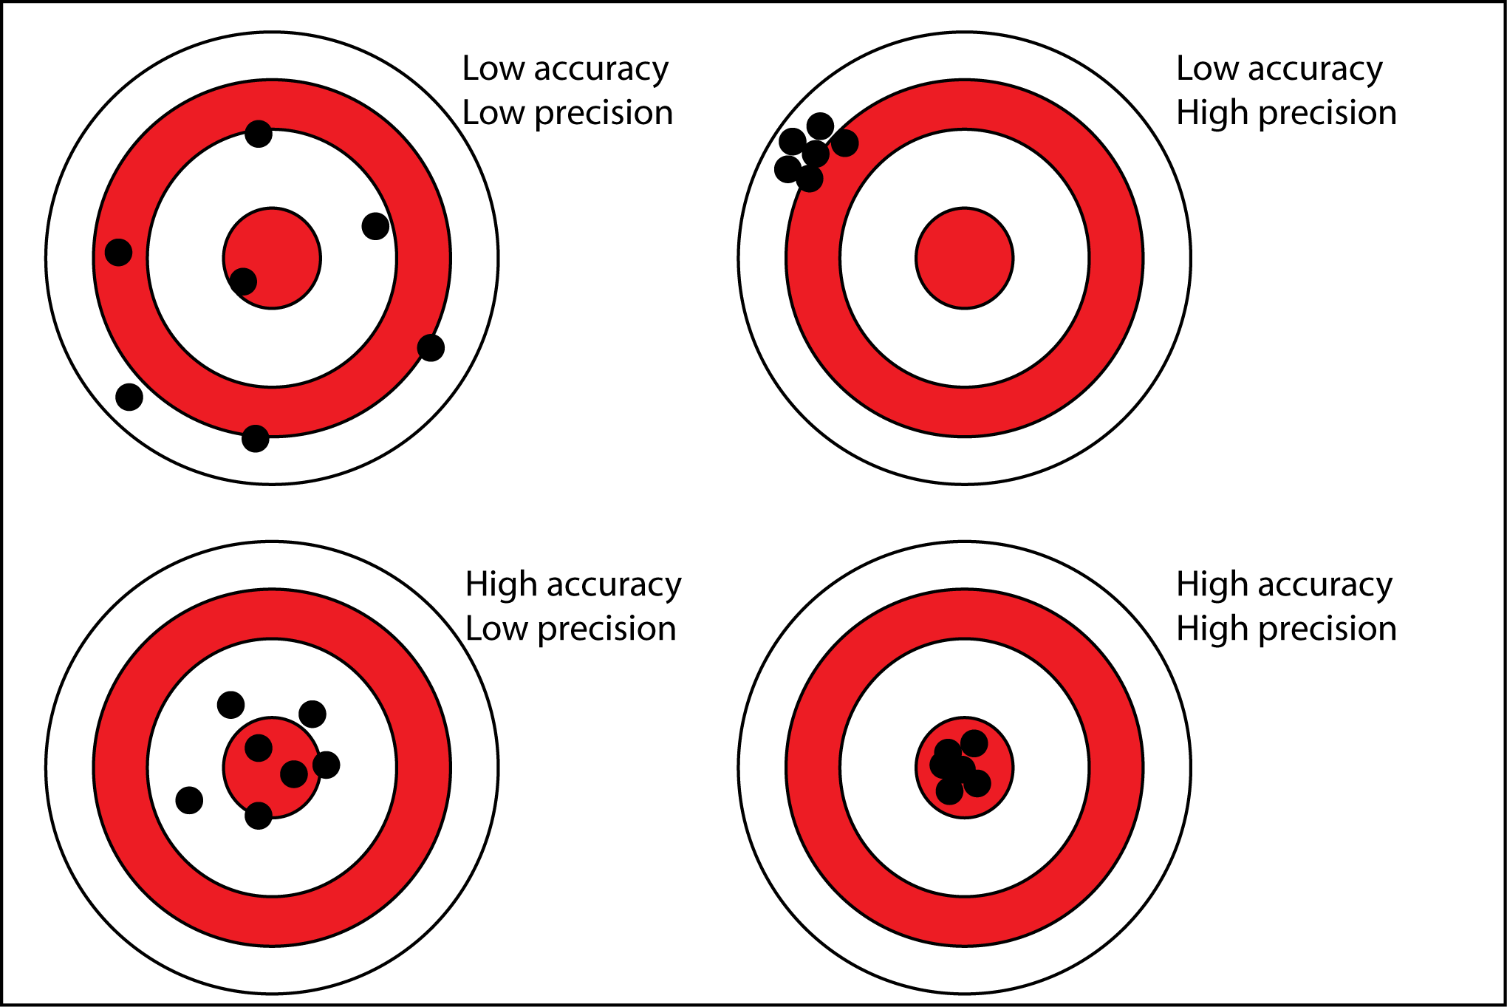
Designing successful sampling to evaluate abundance and density
Low effort, design could be good or bad
Likely high effort, but bad design
Not high enough effort, good design
High enough effort, good design
Trade-offs between accuracy / precision of estimates and effort / cost

Slide 9
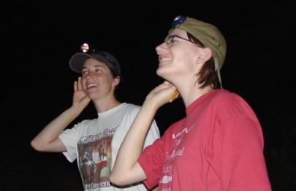
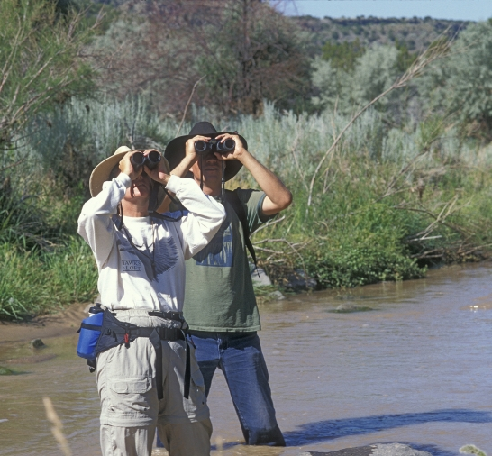
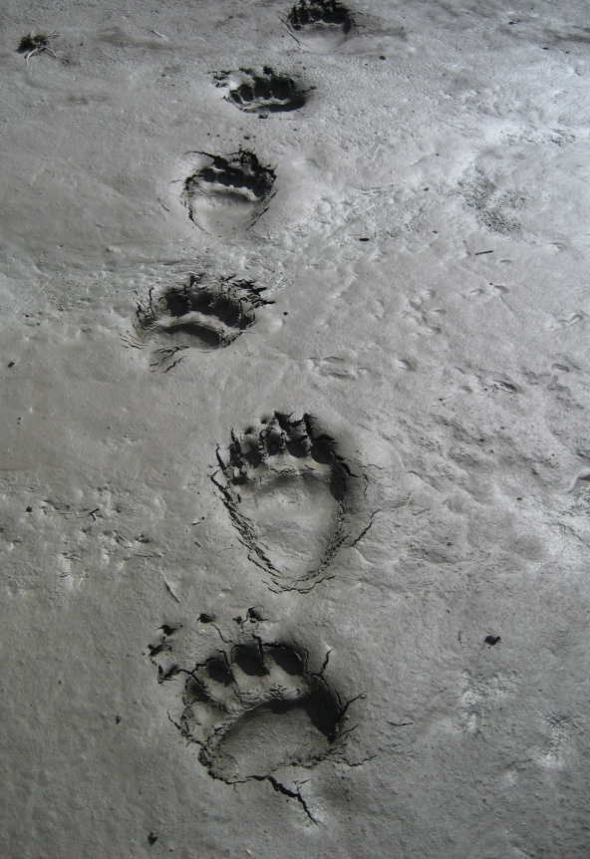
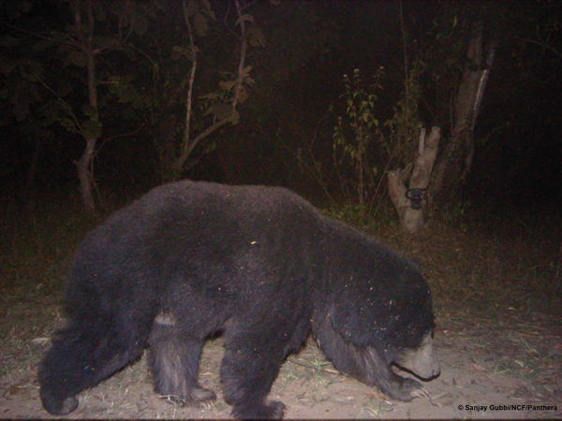
Two main types of data: 1) Unmarked individuals
Call Surveys
Visual Surveys
Track Surveys
Photo captures
Notes:
9

Slide 10
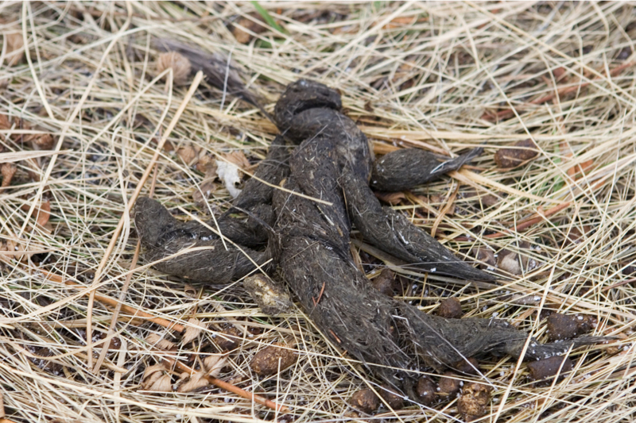
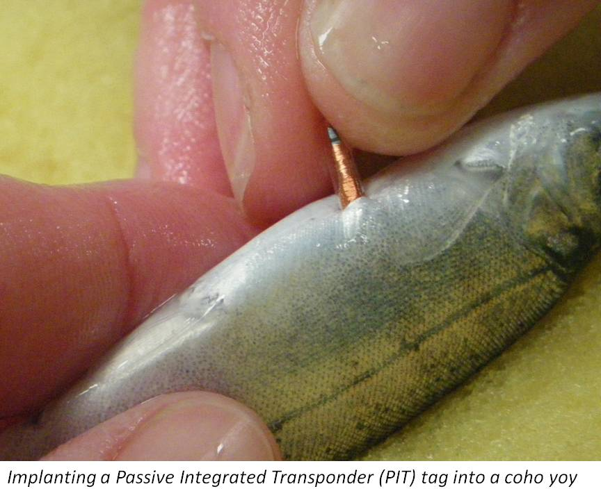
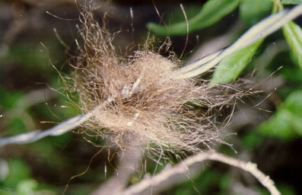
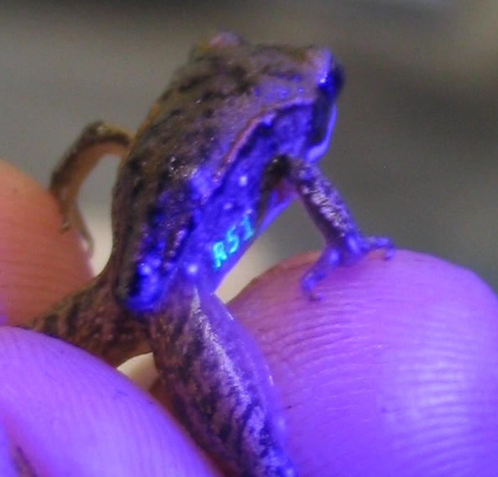
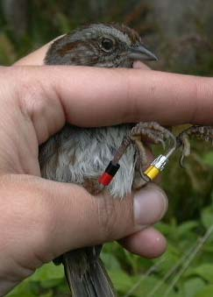
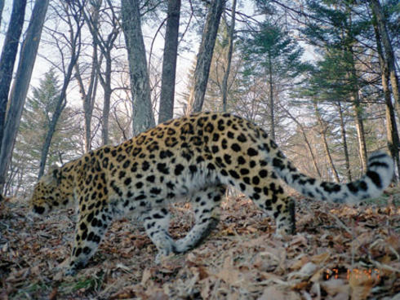
Two main types of data: 2) Marked individuals
Genotyping
PIT tags
Elastomer tags
Bird bands
Photo captures (pattern recognition)
Notes:
10

Slide 11
1) Unmarked individuals
PROS
CONS
Relatively cheap
Less time intensive
Rapid assessment
Does not involve handling animals
Can be done for multiple species simultaneously
Can only provide relative abundances
Unreliable for estimating population trends (usually large confidence intervals)
Of limited use for some management and conservation applications (e.g., hunting, setting population increase targets)
2) Marked individuals
Can provide absolute abundances
Best for estimating population trends (usually tight confidence intervals)
Best for conservation and management, but not always attainable
More expensive (e.g., genotyping) and time consuming
May involve handling animals (except camera trapping and genotyping)
Usually focuses on a single species
Notes:
11

Slide 12
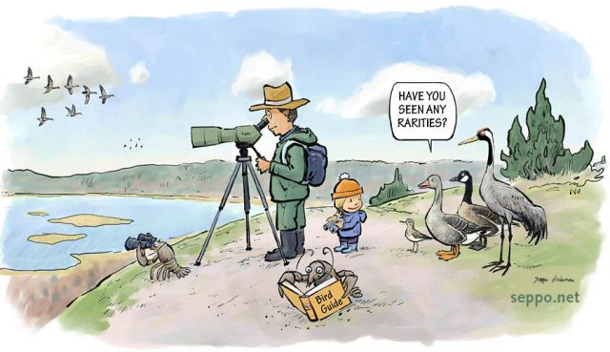
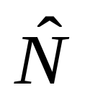
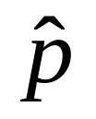
Detectability – key quantity in monitoring
Not accounting for detection underestimates abundance because the observer cannot see REALITY (cannot count ALL individuals present at a site)
Count of animals
observed
C
Estimated
abundance
=
Estimated
detectability
Common abundance estimation techniques include:
Distance sampling (unmarked individuals)
Occupancy methods (unmarked individuals)
Capture-recapture methods (marked individuals)
Notes:
12
SOME SIMPLE EXAMPLES OF HOW TO INC. THESE NON-STANDARD FACTORS INTO MODELS…. e.g. if p = 0.5…

Slide 13


Distance sampling
Assumes that detection probability decreases with distance from the observer, but that actual density stays constant
Detection
probability
Distance
50 meters
25 meters
10 meters
p=0.5
p=1.0
p=0.25
Notes:
13

Slide 14
Capture-recapture methods
Capture
  physical capture
  non-invasive techniques: genetics (from hair snares, scat, etc.), ID unique patterns remotely
Mark
    Radiotelemetry, PIT tags, banding, elastomer, photography, genotyping
Recapture (or resight)
Notes:
14
Important tools for estimating N for mobile speices…. 1. Research CAPTURES, MARKS, and RELEASES as many individuals as possilbe, # Marked = M
2. Allows enough time for the marked individuals to mix intot the whole populaiton, then
3. Resampled the poupplation recording how many individuals are sampled (s) and how many of them possed the mark from the 1st visit and are therefore recaptured (r)

Slide 15
Capture-recapture methods
Open versus closed populations
Closed population – a population in which there is no recruitment (birth or immigration) or losses (death or emigration) during the period of study. Geographic and demographic closure.
Open population – a population that changes in size and composition due to births, deaths, and permanent movements (immigration and emigration)
Notes:
15
Important tools for estimating N for mobile speices…. 1. Research CAPTURES, MARKS, and RELEASES as many individuals as possilbe, # Marked = M
2. Allows enough time for the marked individuals to mix intot the whole populaiton, then
3. Resampled the poupplation recording how many individuals are sampled (s) and how many of them possed the mark from the 1st visit and are therefore recaptured (r)

Slide 16
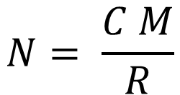
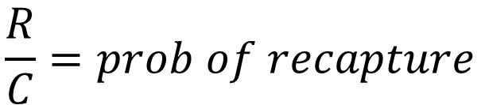
Abundance estimation in CLOSED POPULATIONS
Mark-recapture at its simplest:
the Lincoln-Peterson estimator
Design: visit site TWICE
first visit: count and mark all animals found (marks not unique)
second visit: count all marked and unmarked animals caught
M = Number marked the first visit
C = Total number captured on 2nd sampling occasion
R = Number captured on 2nd sampling occasion which have been marked (recaptures)
$$N= \frac{C M}{R}$$
$$\frac{R}{C}=prob of recapture$$
Notes:
16
1. Research CAPTURES, MARKS, and RELEASES as many individuals as possilbe, # Marked = M
2. Allows enough time for the marked individuals to MIX back into the POPULATION,
3. RESAMPLES the POPULATIONS, recording how many individuals sampled (S) and how many of them possed the mark from the 1st visit and are therefore recaptured (r)
Assuming that the proportion of the total population that was marked during the first sampling m/N is = to the proportion that individuals aptured during 2nd period that were recaptured……
IMPORTANCE of UNDERSTANDING THE DIRECTION OF BIASES – MEANS WE CAN MODEL THEM!!

Slide 17
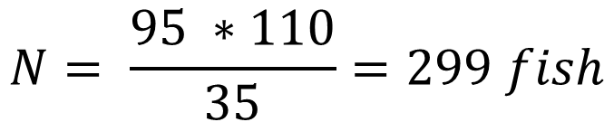
Abundance estimation in CLOSED POPULATIONS
Mark-recapture at its simplest:
the Lincoln-Peterson estimator
M = Number marked the first visit
C = Total number captured on 2nd sampling occasion
R = Number captured on 2nd sampling occasion which have been marked (recaptures)
$$N= \frac{C M}{R}$$
$$\frac{R}{C}=prob of recapture$$
Let’s assume we sample a popn. of fish
M = 110
C = 95
R = 35
$$N= \frac{95 ∗110}{35}=299 fish$$
Notes:
17
1. Research CAPTURES, MARKS, and RELEASES as many individuals as possilbe, # Marked = M
2. Allows enough time for the marked individuals to MIX back into the POPULATION,
3. RESAMPLES the POPULATIONS, recording how many individuals sampled (S) and how many of them possed the mark from the 1st visit and are therefore recaptured (r)
Assuming that the proportion of the total population that was marked during the first sampling m/N is = to the proportion that individuals aptured during 2nd period that were recaptured……
IMPORTANCE of UNDERSTANDING THE DIRECTION OF BIASES – MEANS WE CAN MODEL THEM!!

Slide 18
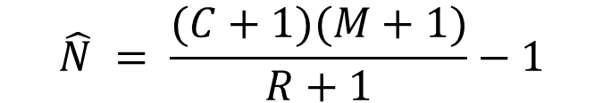
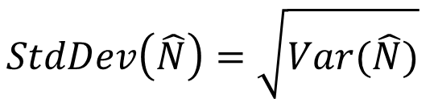
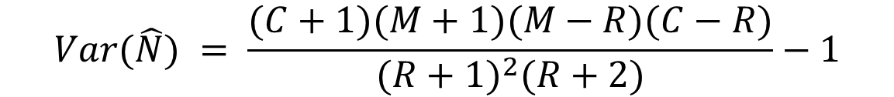
Abundance estimation in CLOSED POPULATIONS
Modified L-P estimator (Chapman estimator)
SAME design as L-P
BUT, we need to account for sampling uncertainty (i.e., do we get the same numbers of C, M, R if we repeated the sampling 100 times in the same population?)
$$\hat{N} = \frac{(C+1)(M+1)}{R+1}−1$$
Let’s assume we sample a popn. of fish
M = 110
C = 95
R = 35
Compute Sampling Variance
$$Var(\hat{N}) = \frac{(C+1)(M+1)(M−R)(C−R)}{{(R+1)}^{2}(R+2)}−1$$
$$StdDev\left(\hat{N}\right)=\sqrt{Var(\hat{N})}$$
$$95\% CI of \hat{N}= \hat{N} ±1.96 ∗StdDev(\hat{N})$$
Notes:
18

Slide 19
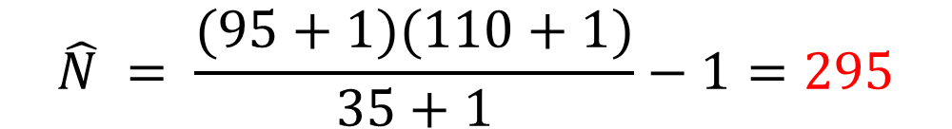
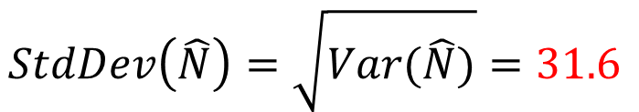
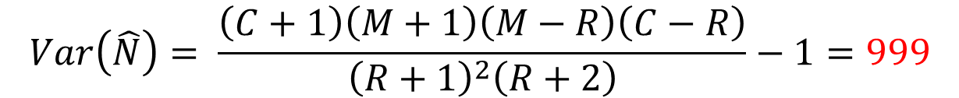
Abundance estimation in CLOSED POPULATIONS
Modified L-P estimator (Chapman estimator)
Let’s assume we sample a popn. of fish
M = 110
C = 95
R = 35
$$\hat{N} = \frac{(95+1)(110+1)}{35+1}−1=295$$
$$Var\left(\hat{N}\right)= \frac{\left(C+1\right)\left(M+1\right)\left(M−R\right)\left(C−R\right)}{{\left(R+1\right)}^{2}\left(R+2\right)}−1=999$$
$$StdDev\left(\hat{N}\right)=\sqrt{Var(\hat{N})}=31.6$$
$$95\% CI of \hat{N}= \hat{N} ±1.96 ∗StdDev\left(\hat{N}\right)=295 ±62$$
Notes:
19

Slide 20
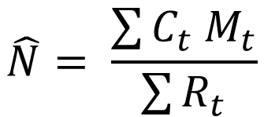
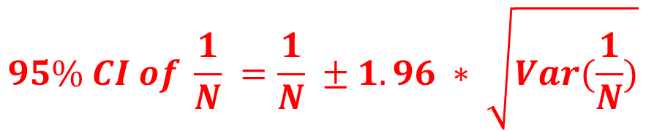
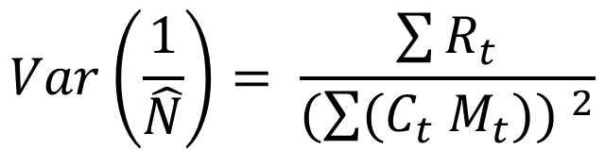
Abundance estimation in CLOSED POPULATIONS
Schnabel Estimator
Design: visit site multiple times
mark all animals during first visit
subsequent visits – mark all the unmarked animals (no unique marks needed)
C_{t} = Total number of individuals captured during visit t
R_{t} = Number of previously-marked individuals (Recaptures) captured in visit t (the remainder of individuals captured in visit t must be given a new mark)
M_{t} = Total number of marked animals in the population just before the t^{th} site visit.
$$\hat{N}= \frac{\sum{C_{t} M_{t}}}{\sum{R_{t}}}$$
R varies by sampling occasion, so N is basically a weighted average of L-P estimates
$$Var\left(\frac{1}{\hat{N}}\right)= \frac{\sum{R_{t}}}{(\sum{{(C}_{t} M_{t}})) ^{2}}$$
$$95\% CI of \frac{1}{N} =\frac{1}{N} ±1.96 ∗ \sqrt{Var(\frac{1}{N})}$$
Notes:
20

Slide 21
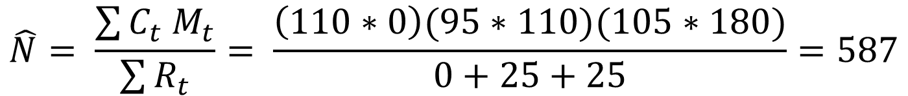
Abundance estimation in CLOSED POPULATIONS
Schnabel Estimator
C_{t} = Total number of individuals captured during visit t
R_{t} = Number of previously-marked individuals (Recaptures) captured in visit t (the remainder of individuals captured in visit t must be given a new mark)
M_{t} = Total number of marked animals in the population just before the t^{th} site visit.
Sampling occasion | Ct | Rt | New marked | Mt
1 | 110 | 0 | 110 | 0
2 | 95 | 25 | 70 | 110
3 | 105 | 25 | - | 180
$$\hat{N}= \frac{\sum{C_{t} M_{t}}}{\sum{R_{t}}}= \frac{\left(110∗0\right)(95∗110)(105∗180)}{0+25+25}=587$$
Notes:
21

Slide 22
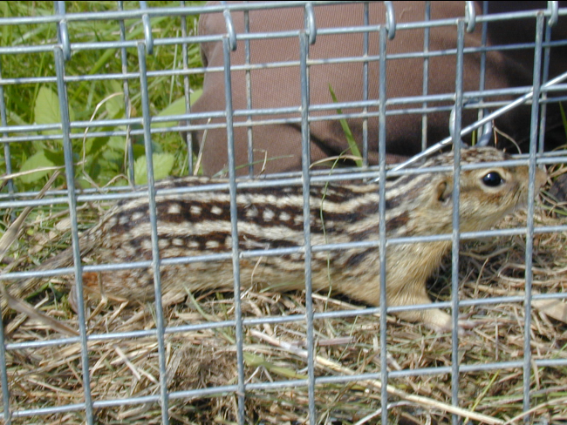
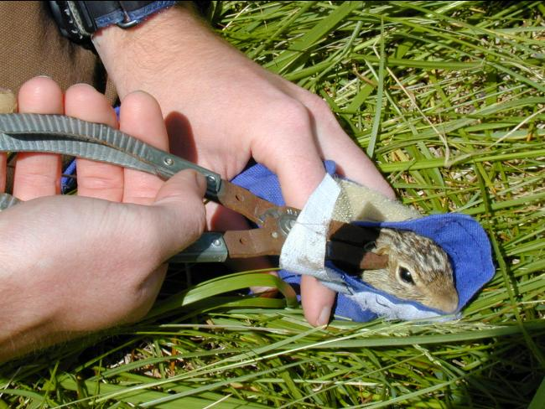
Assumptions for the L-P estimator and friends
Population is “closed”: between sessions, no animals leave or enter study area, are born, or die
All individuals have equal probability of being captured
No effect of marking on probability of recapture or survival
Mixing of marked and unmarked individuals
Marks are not lost
Notes:
22
Visual detection of tags, slow individuals down….

Slide 23
Open Populations
Population is open to one or more of the BIDE processes
  abundance CAN change and attempt to estimate the processes driving abundance change (often, survival rates; emigration and immigration are trickier)
Enables estimation of the drivers of population dynamics over extended time periods
PROGRAM MARK (to date >100 different variations of capture-recapture models have been developed): http://www.phidot.org/software/mark/
Notes:
23

Slide 24
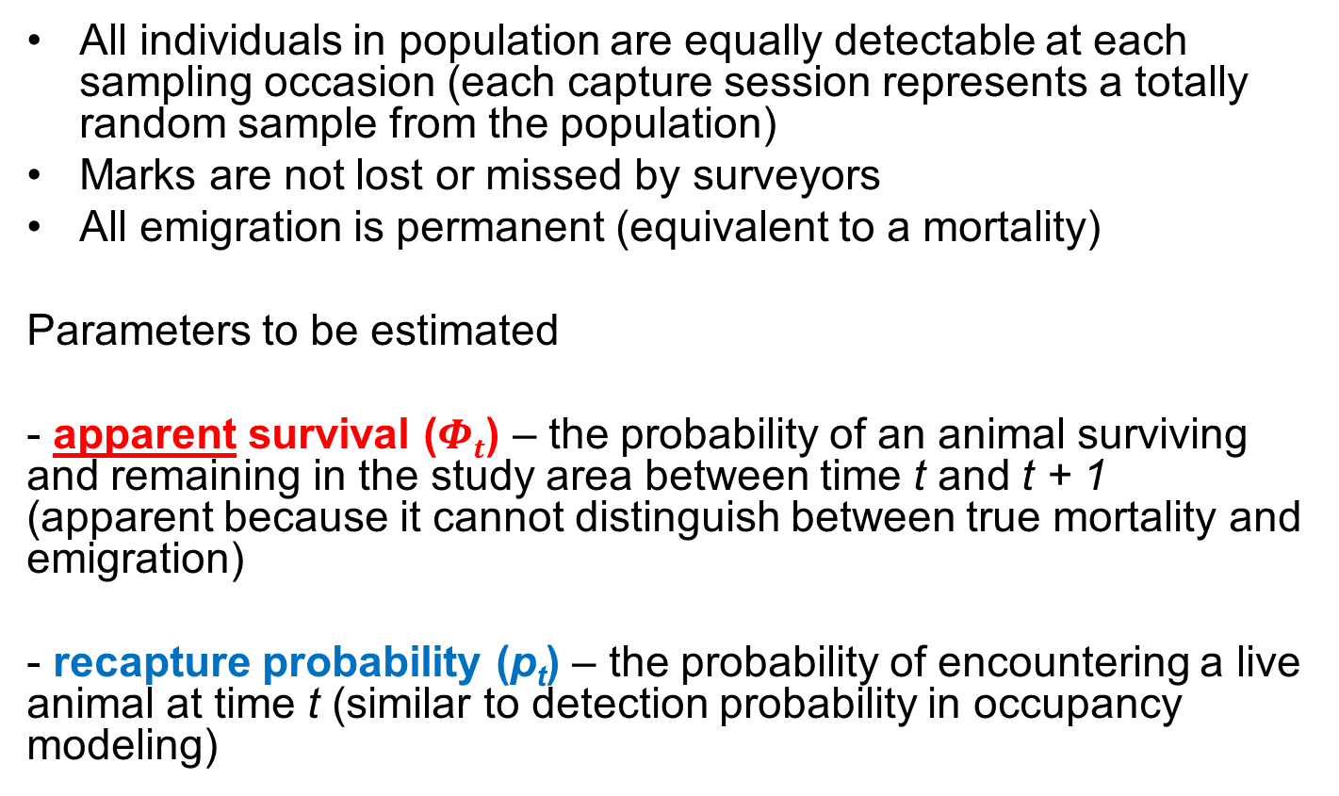
Cormack-Jolly-Seber
Open Population Model
All individuals in population are equally detectable at each sampling occasion (each capture session represents a totally random sample from the population)
Marks are not lost or missed by surveyors
All emigration is permanent (equivalent to a mortality)
Parameters to be estimated
- apparent survival ($Φt$) – the probability of an animal surviving and remaining in the study area between time t and t + 1 (apparent because it cannot distinguish between true mortality and emigration)
- recapture probability (p_{t}) – the probability of encountering a live animal at time t (similar to detection probability in occupancy modeling)
Notes:
24

Slide 25
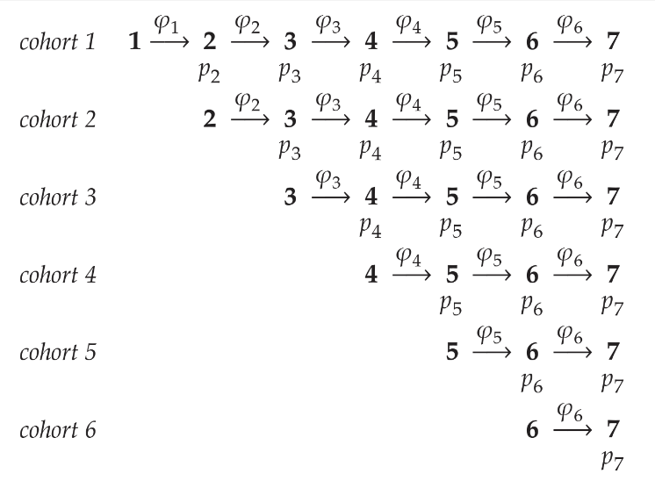

Cormack-Jolly-Seber (CJS)
Open Population Model
Consider the following model:
$$\left\{Φ_{t}, p_{t}\right\}$$
survival and recapture vary by time
A cohort is released and survives and is recaptured with different prob’s each time
Notes:
25

Slide 26
Cormack-Jolly-Seber (CJS)
Open Population Model
Consider the following model:
$$\left\{Φ_{t}, p_{t}\right\}$$
survival and recapture vary by time
More animals are marked and released into the population each subsequent survey, aka new ‘cohorts’
We have 6 estimates for survival and 6 for recapture
Notes:
26

Slide 27

Cormack-Jolly-Seber (CJS)
Open Population Model
Consider the following model:
$$\left\{Φ_{t}, p\right\}$$
recapture DOES NOT vary by time
How many survival and recapture estimates?
Still 6 estimates for survival, but only 1 for recapture (constant recapture prob through time)
Notes:
27

Slide 28

Cormack-Jolly-Seber (CJS)
Open Population Model
Consider the following model:
$$\left\{Φ, p\right\}$$
neither parameter varies by time
How many survival and recapture estimates?
Only 1 estimate for survival and only 1 for recapture (constant surv and recapture prob through time)
Notes:
28

